Slide 1

Choosing a neighborhood in Moscow
Clustering neighborhoods based on price and similarity
Lidia Shilovich, May 2020

Slide 2
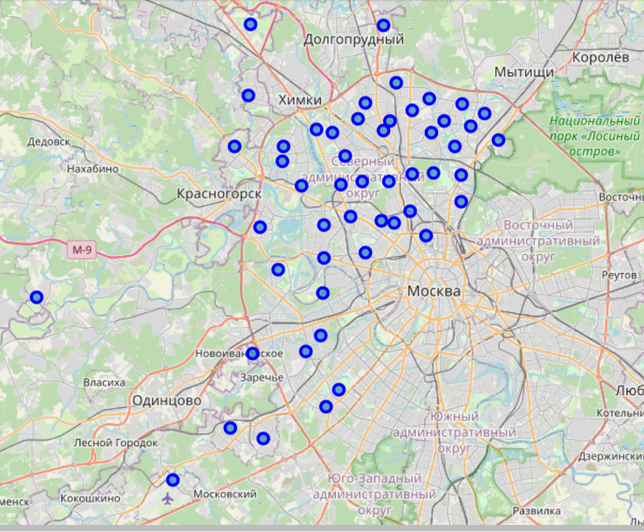
Pre-selection of neighborhoods in Moscow based on price
Database of neighborhoods after price clustering
Our initial neighborhood is Щукино, located to the North-West of Moscow.
Price clustering excluded neighborhoods, that were too expensive and I manually excluded boroughs, that are too far from the place, where I live.

Slide 3
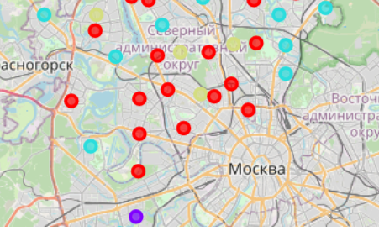
Results of clustering based on Foursquare data
The neighborhoods marked as red are similar to out initial neighborhood.

